Slide 1
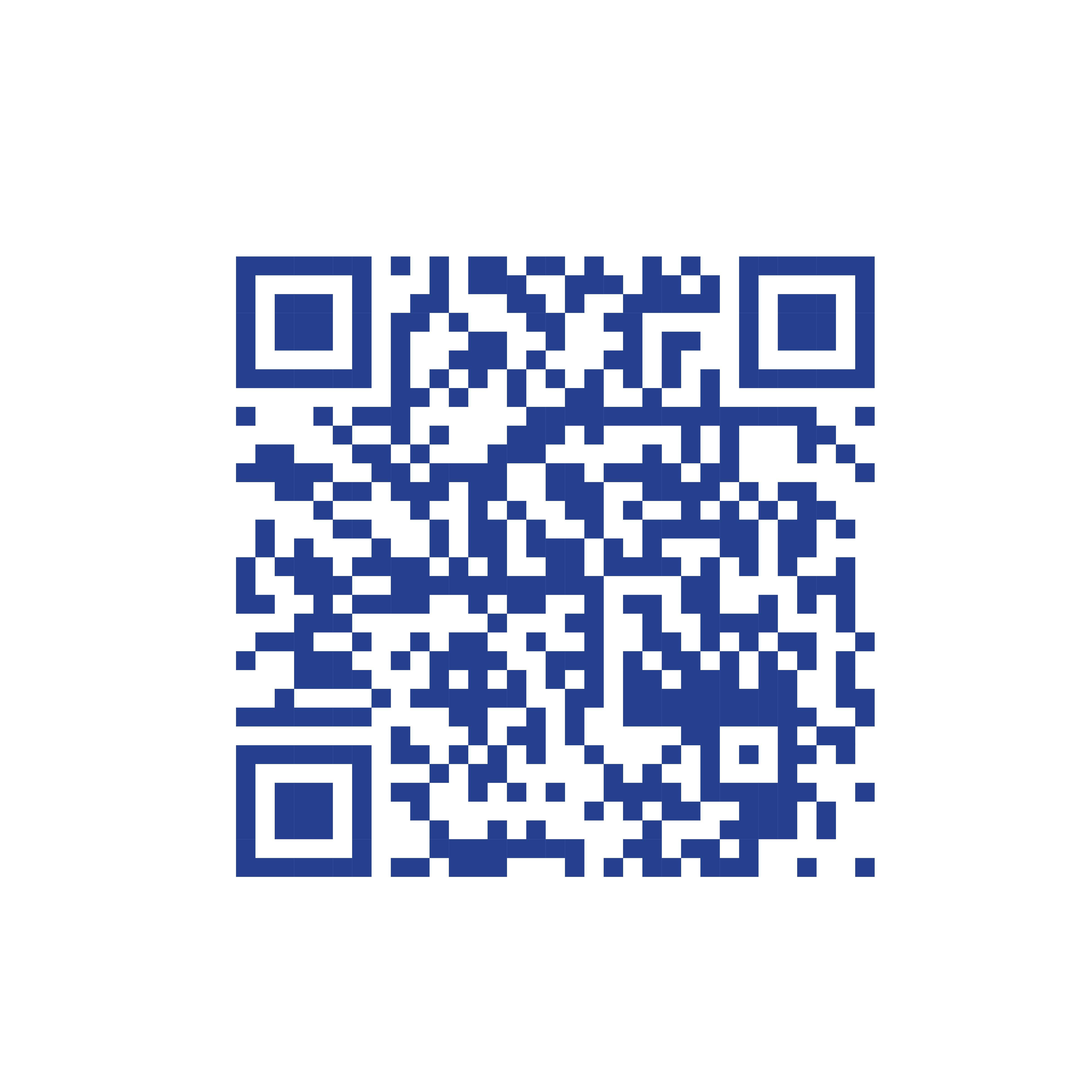
2022 International Student Speech Contest
WIN A $2,000
LEADERSHIP GRANT!
USD
Learn more at www.leaderinme.org/student-speech-contest-2022/
All K-12 students (ages 5–19) attending a Leader in Me School (in over 50 countries) are encouraged to participate in the largest and most inspiring student speech contest in the world for a chance to win a $2,000 USD leadership grant! Contest entries are due by February 28, 2022.
ABOUT THE CONTEST
Students are encouraged to demonstrate their leadership skills by identifying a need in their community or the world that they want to do something about and submitting up to a five (5) minute video reporting on their leadership project.
WHAT IS A LEADERSHIP GRANT?
The purpose of a leadership grant is to inspire and enable students to be life-ready leaders and use the grant to make a difference within their circle of influence. The decision is up to the student, but ideas might include: Organizing a service project, donating the money as a charitable contribution, or contributing to a college fund, etc.
For additional details on contest entry categories and the 2022 judging rubric, please visit www.leaderinme.org/student-speech-contest-2022
© Franklin Covey Co. All rights reserved. Version 1.0.4

